Slide 1

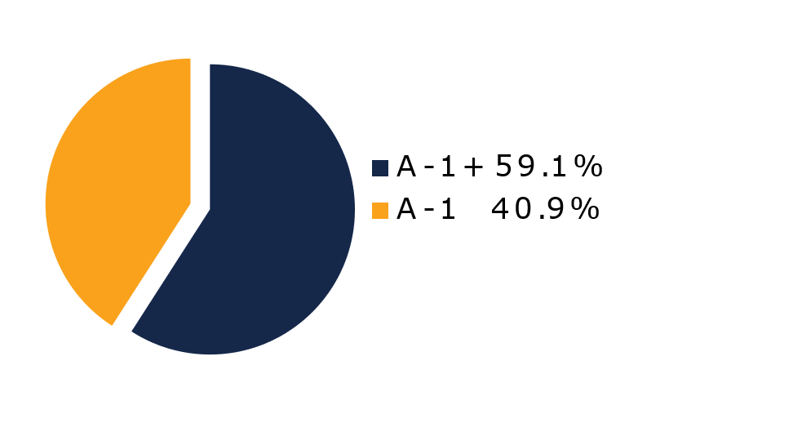
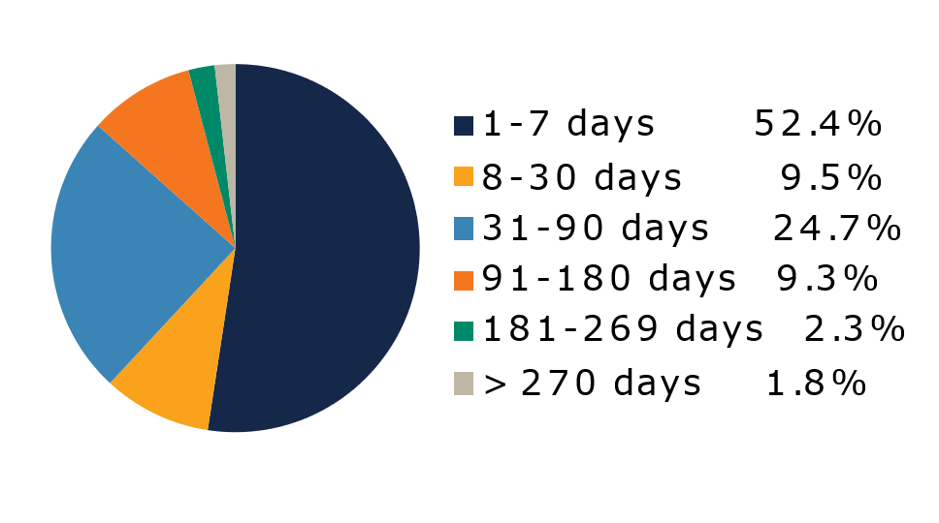
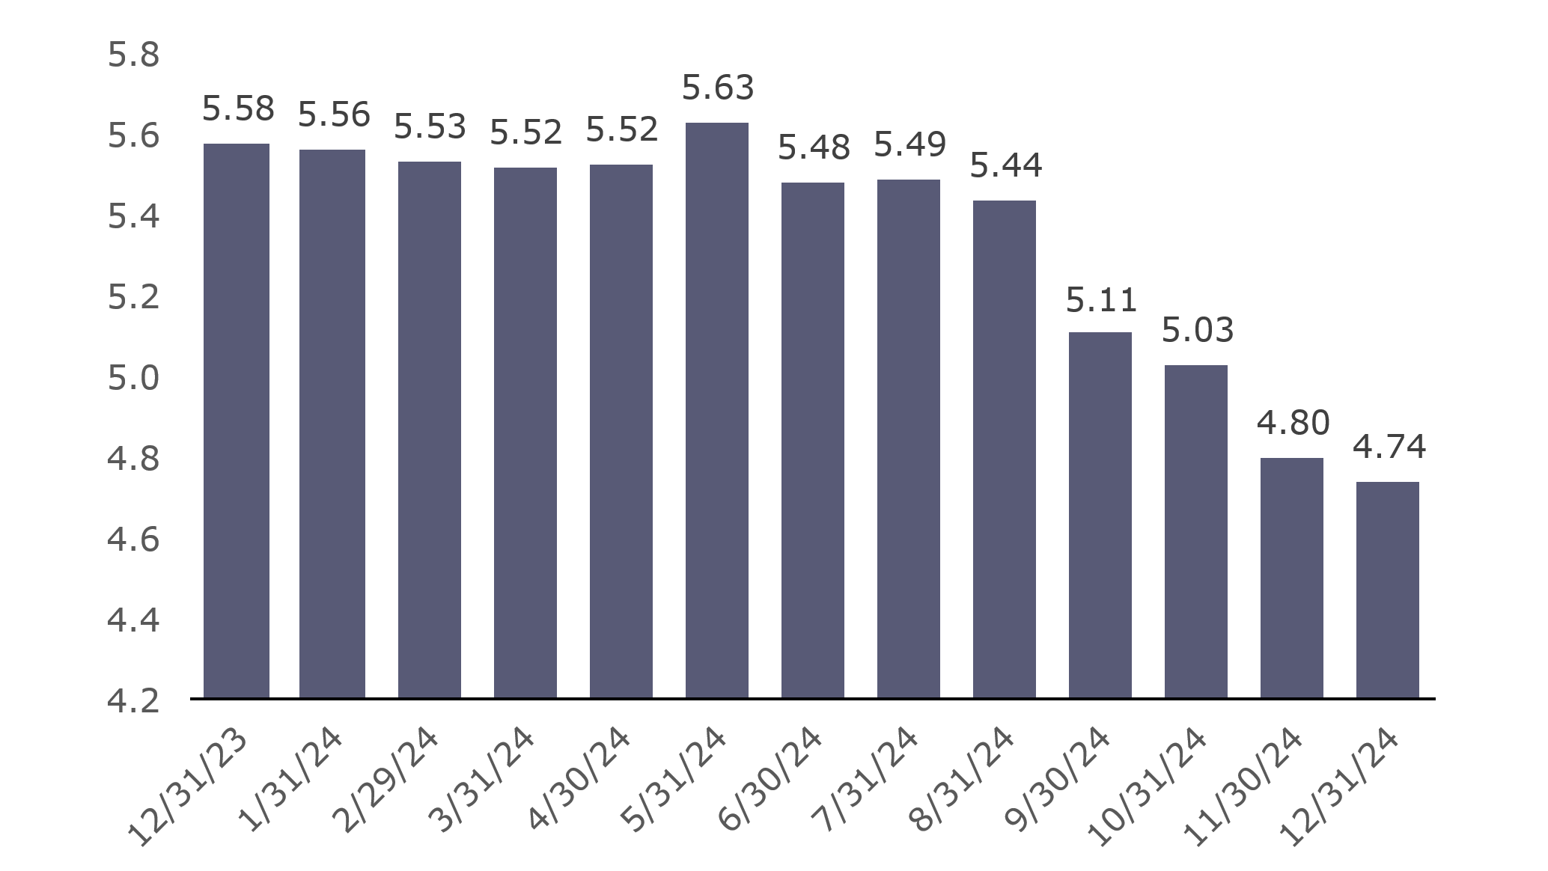
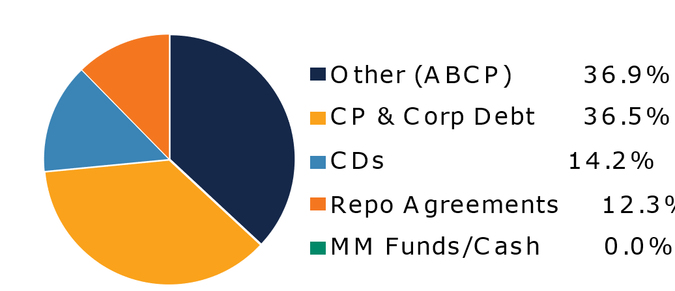
West Virginia Money Market Pool
Portfolio Overview as of 12/31/2024
Pool Assets
$9.1 billion
The West Virginia Money Market Pool is a money market portfolio created to invest the majority of the state and local government operating funds. The objective of the portfolio is to maintain sufficient liquidity to meet the needs of the participants while striving to earn a return above inflation. The risk factor is low and managed through numerous maturity restrictions, diversification, guidelines, and credit limits.
Pool Features and Benefits:
Professional management is provided by the West Virginia Board of Treasury investments’ staff and professional investment advisors (Federated Hermes and UBS Global Asset Management). Rated AAAm by Standard & Poor’s. Seeks to maintain a net asset value (NAV) of $1 per share. Investment yields are competitive with other money market accounts. Easy access is provided through the State Treasurer’s Office online system. Account can be opened for as little as $100 with no limit on the number of transactions. Contributions and withdrawals are allowed daily. Income is distributed on a daily basis.
7-Day Simple Money Market Yield (%)
To learn how to make the West Virginia Money Market Pool work for your cash investing needs call: 304-340-1564 or visit: wvbti.org
Portfolio holdings and composition are shown as of the date indicated. Since market conditions fluctuate suddenly and frequently, the portfolio holdings may change and this list is not indicative of future portfolio composition. These portfolio holdings are not intended to be and do not constitute recommendations that others buy, sell, or hold any of the securities listed. An investment in the Pool is not insured or guaranteed by any government or government agency. Although the manager of the Pool seeks to preserve principal, it is possible to lose money by depositing money in the Pool. A AAAm rating by Standard & Poor’s is obtained after S&P evaluates a number of factors, including credit quality, market price exposure and management. Ratings are subject to change and do not remove market risk.
Credit Quality Composition (%)
Maturity Schedule (%)
Portfolio Composition (%)
Weighted Average Maturity
38 Days
Top Holdings (%)

Slide 2
Board of Treasury Investments | Fact Sheet
Commentary
A gorgeous vista for cash managers
After a year of ever-changing clouds, monetary policy looks clearer in 2025. The Federal Reserve seems to finally have realized it miscalculated in September by slashing rates. Inflation had already plateaued and the labor market was weakening, but hardly weak. Faced with a strong economy, officials have wised up to the reality that policy must be restrictive for longer and now project just two quarter-point cuts this year. In retrospect, it’s odd that Chair Jerome Powell eagerly supported the easing campaign, as he consistently says he wants to avoid the Fed’s mistake of easing too early in the 1970s. He has to be careful. Losing favor with Trump has nothing on losing credibility with investors or his colleagues—the latter hinted at with recent FOMC dissents. But if this newly cautious Fed makes good on its revised projections, the slower pace is great news for the money markets, as it could mean yields will be even more attractive.
It’s problematic enough that inflation has been persistent. If it starts to meaningfully rise, look out. But that’s the danger of some of the policies Trump has promised to enact. While the post-Covid economy has not followed textbooks, a potential combination of more federal tax cuts, expanded government expenditures, additional tariffs and significant deportations could increase price pressures. While that might not be felt in 2025, the Fed might try to counter fiscal policy by further slowing the pace of cuts. The potential impact on liquidity products? See the previous paragraph's last sentence above, with an emphasis on “even more.”
Trump’s desire to reduce regulations is sure to be disruptive but might lead to calm at the SEC—and less market interference. The majority of the five commissioners will flip Republican, and the new administration has a pro-business agenda. The private sector is going to have more input, too. Outgoing Chair Gary Gensler had an adversarial relationship with financial institutions and issued many rules, some we feel were unnecessary, without proper dialogue with market participants. A healthy dynamic between the agency and markets should emerge if Trump’s nominee, Paul Atkins, is confirmed. Expect more sensible regulations and attempts to rollback some onerous ones implemented under Gensler.

