Slide 1

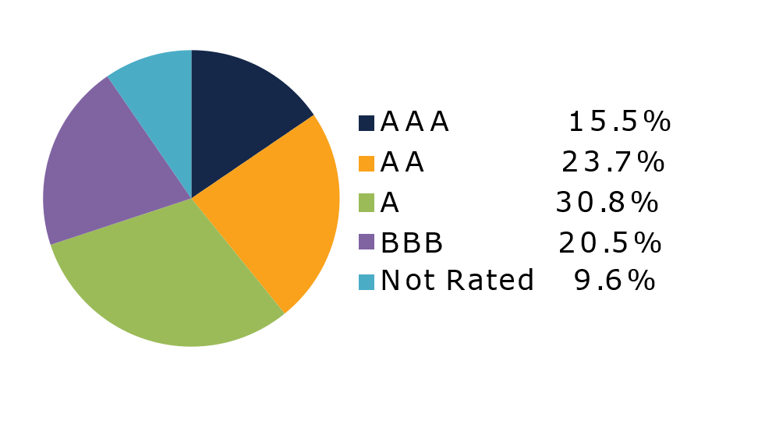
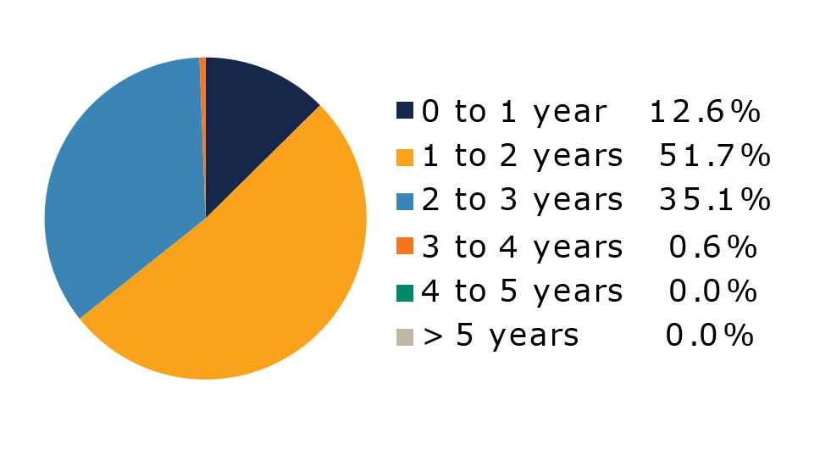
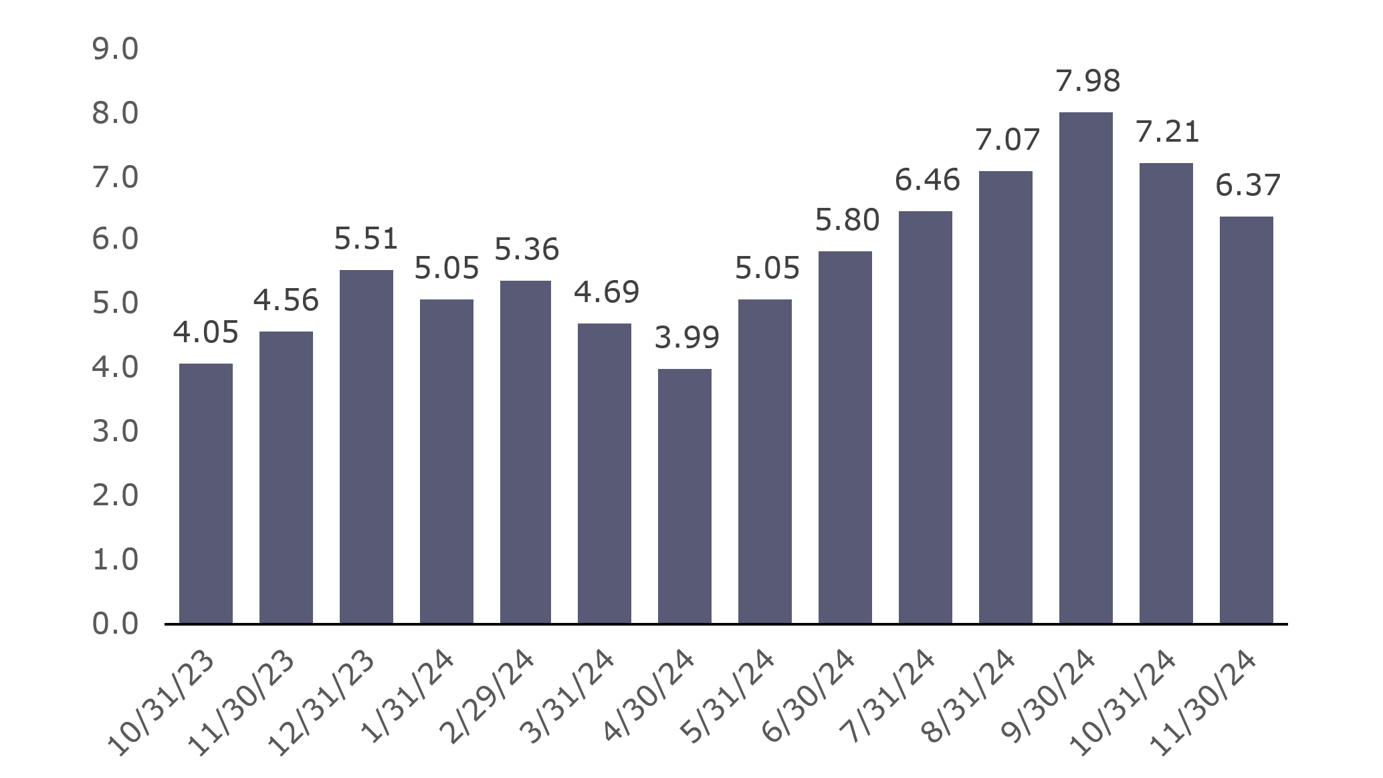
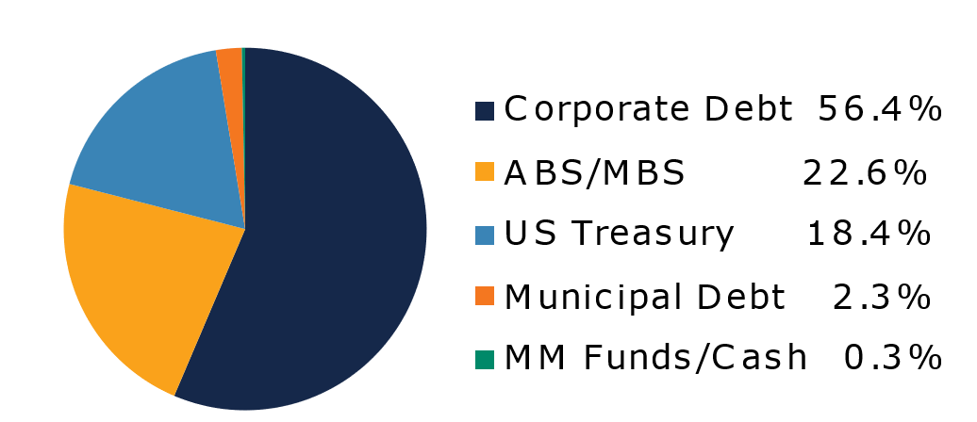
West Virginia
Short Term Bond Pool
Portfolio Overview as of 12/31/2024
Pool Assets
$705 million
The West Virginia Short Term Bond Pool was created to invest restricted moneys of participants which have a longer-term investment horizon. The objective of the portfolio is to earn an incremental return over the WV Money Market Pool with an objective of asset growth rather than current income. The risk factor is higher than the WV Money Market Pool and is managed through numerous maturity restrictions, diversification, guidelines, and credit limits.
Pool Features and Benefits:
Professional management is provided by the West Virginia Board of Treasury investments’ staff and professional investment advisor (Sterling Capital Management). Floating net asset value (NAV). Investment yields are competitive with other short duration fixed income pools. Easy access is provided through the State Treasurer’s Office online system. Account can be opened for as little as $100 with no limit on the number of transactions. Contributions and withdrawals are allowed monthly. Income is distributed on a monthly basis.
Return Summary
To learn how to make the West Virginia Short Term Bond Pool work for your cash investing needs call: 304-340-1564 or visit: wvbti.org
Portfolio holdings and composition are shown as of the date indicated. Since market conditions fluctuate suddenly and frequently, the portfolio holdings may change and this list is not indicative of future portfolio composition. These portfolio holdings are not intended to be and do not constitute recommendations that others buy, sell, or hold any of the securities listed. An investment in the Pool is not insured or guaranteed by any government or government agency and it is possible to lose money by depositing money in the Pool.
Credit Quality Composition (%)
Maturity Schedule (%)
Portfolio Composition (%)
Effective Duration
627 Days
Top Holdings (%)

Slide 2
Board of Treasury Investments | Fact Sheet
Commentary
As investors continued to digest the results of the U.S. elections the previous month, the FOMC took center stage with their mid-December meeting. While the committee chose to cut the fed funds rate by 25bps as expected, the Summary of Economic Projections (the so called “dot plot”) released after the meeting showed a growing hawkishness among members. Although only one member formally dissented from the decision to cut 25bps, the dot plot showed that four participants preferred not to cut rates in December, and a majority of the 19 participants expect the fed funds rate to decline by 50bps or less in 2025. Additionally, the FOMC’s median projections for U.S. GDP in 2025 were revised up by 0.1% to 2.1% and the median forecast for core Personal Consumption Expenditures (PCE, the FOMC’s preferred measure of inflation) was revised up by 0.4% to 2.5%, well above the committee’s 2% target. When asked why the FOMC chose to cut rates at all at this meeting given these new forecasts, Chair Jerome Powell responded that the current level of rates is still restrictive and consistent with achieving the FOMC’s goals. The hawkish shift from the Fed and Powell’s attempts to explain it injected some volatility into financial markets, as two-year Treasury yields jumped 0.15% on the day of the FOMC meeting while equity markets slumped. While yields rallied over the last two days of the year, the two-year Treasury yield ended December nine basis points higher.
The performance of short duration corporate bonds remained solid over the first two weeks of December as issuers brought the last few deals of the year. Investment-grade issuance for December totaled $42 billion and reached $1.5 trillion for the year, the highest annual issuance total since 2020. Spreads remained unchanged for the month until cracks began to emerge following the FOMC meeting, when rising interest rate and equity volatility caused risk premia in corporates to rise in sympathy. Additionally, dealers reported that although investors continued to buy more corporate bonds than they sold over the last few weeks of the year, shorter maturity bonds were disproportionately used as a funding source to cover outflows and other purchases. Despite a complete lack of issuance over the back half of December, the option-adjusted spread on the Bloomberg U.S. Corporate 1-3Y Index widened seven basis points, underperforming duration-matched Treasuries by 0.08%.
Agency mortgage-backed securities (agency MBS) also suffered from rising interest rate volatility in the wake of the December FOMC meeting and underperformed Treasuries by 0.17% for the month. However, non-agency securitized products like asset-backed securities (ABS) and commercial mortgage-backed securities (CMBS) fared much better thanks to stronger demand and minimal issuance and generated positive excess returns for the month of 0.06% and 0.16%, respectively.
The views expressed represent the opinions of Sterling Capital Management. Any type of investing involves risk and there are no guarantees that these methods will be successful. Data is as of 12.31.2024 unless otherwise stated. Source: Bloomberg L.P. Fed = Federal Reserve. FOMC = Federal Open Market Committee. BPS = basis points. GDP = gross domestic product.

