Slide 1

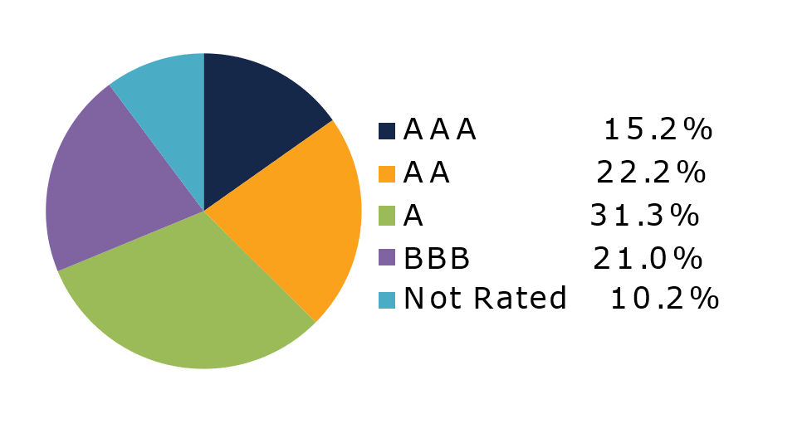
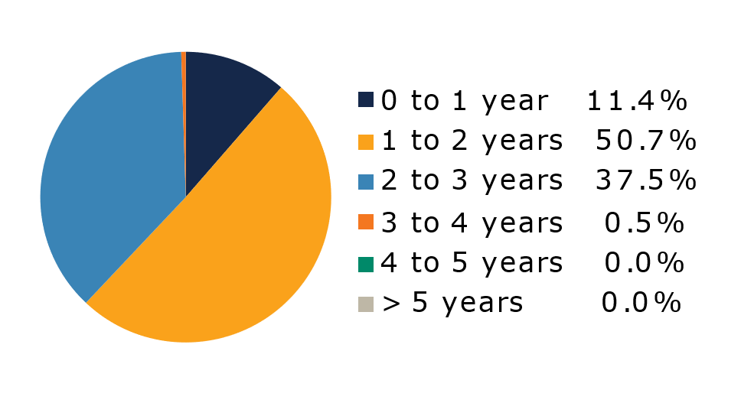
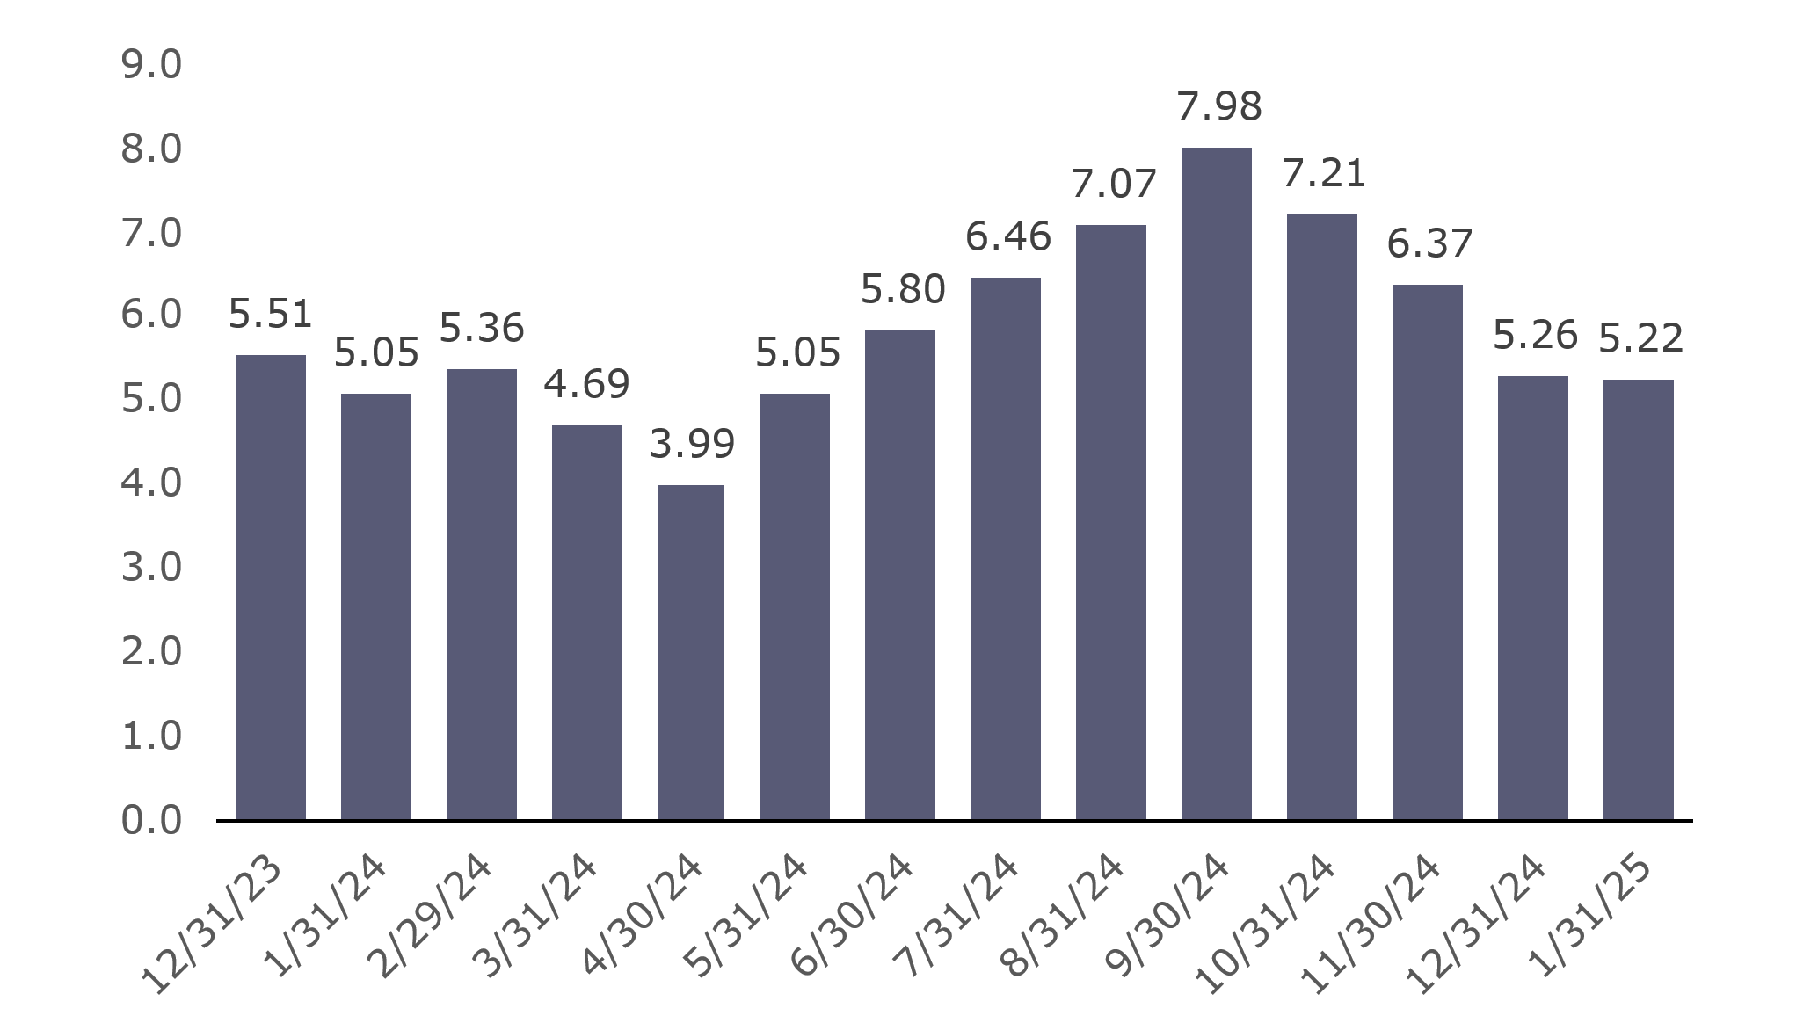
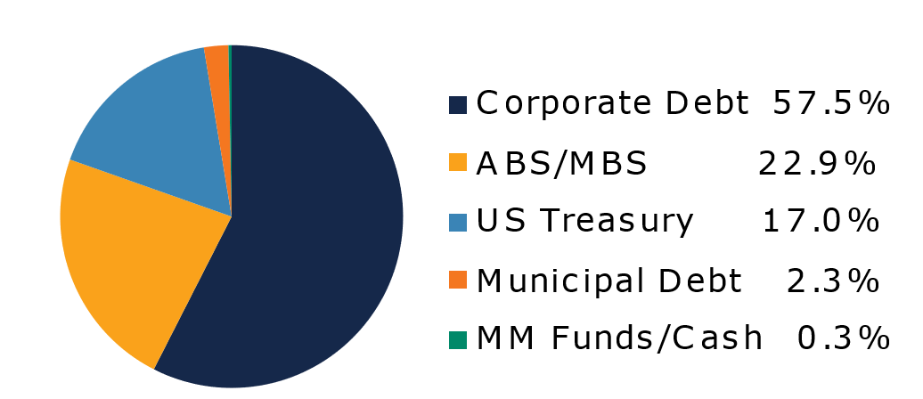
West Virginia
Short Term Bond Pool
Portfolio Overview as of 01/31/2025
Pool Assets
$707 million
The West Virginia Short Term Bond Pool was created to invest restricted moneys of participants which have a longer-term investment horizon. The objective of the portfolio is to earn an incremental return over the WV Money Market Pool with an objective of asset growth rather than current income. The risk factor is higher than the WV Money Market Pool and is managed through numerous maturity restrictions, diversification, guidelines, and credit limits.
Pool Features and Benefits:
Professional management is provided by the West Virginia Board of Treasury investments’ staff and professional investment advisor (Sterling Capital Management). Floating net asset value (NAV). Investment yields are competitive with other short duration fixed income pools. Easy access is provided through the State Treasurer’s Office online system. Account can be opened for as little as $100 with no limit on the number of transactions. Contributions and withdrawals are allowed monthly. Income is distributed on a monthly basis.
Return Summary
To learn how to make the West Virginia Short Term Bond Pool work for your cash investing needs call: 304-340-1564 or visit: wvbti.org
Portfolio holdings and composition are shown as of the date indicated. Since market conditions fluctuate suddenly and frequently, the portfolio holdings may change and this list is not indicative of future portfolio composition. These portfolio holdings are not intended to be and do not constitute recommendations that others buy, sell, or hold any of the securities listed. An investment in the Pool is not insured or guaranteed by any government or government agency and it is possible to lose money by depositing money in the Pool.
Credit Quality Composition (%)
Maturity Schedule (%)
Portfolio Composition (%)
Effective Duration
633 Days
Top Holdings (%)

Slide 2
Board of Treasury Investments | Fact Sheet
Commentary
January brought the second inauguration of Donald Trump as U.S. President, and with it came a flurry of executive orders, including 26 on his first day in office. As promised on the campaign trail, many of these orders aimed to cut regulations and were cheered by American businesses, causing the NFIB Small Business Optimism Index to skyrocket to a five-year high. However, financial markets also quickly felt the downside of Trump 2.0 as the new president threatened to place tariffs on goods imported from major trading partners like Mexico, Canada, China and the European Union in response to a variety of grievances. While the impact of the new administration’s policies will likely take months or even years to be felt, the U.S. economy continued to chug along in the meantime. U.S. employers added an additional 223,000 workers in December as the unemployment rate ticked down to 4.1%. On the inflation front, core consumer prices rose 0.2% month-over-month, but the year-over-year figure remained stuck well above the Fed’s 2% target at 3.2%. Unsurprisingly, with the labor market strengthening again and inflation above their desired range, the FOMC voted to leave the federal funds rate unchanged at their January meeting. Market expectations for further rate cuts this year remained steady with slightly less than two cuts priced in. Accordingly, short term interest rates were little changed on the month, with the two-year Treasury yield moving 0.04% lower.
Despite the threat of tariffs, the continued strength of the U.S. economy and elevated risk appetite maintained downward pressure on corporate bonds spreads. Strong demand for the asset class supported a typically strong January issuance calendar as well and investment grade companies brought nearly $200 billion in new bonds during the month, led by financials. Automakers who stood to see the most impact from tariffs on Mexico and Canada like Ford and General Motors underperformed the broader market, while utilities also saw wider spreads as investors speculated on the causes of the devastating wildfires in southern California. For the month, the option-adjusted spread on the ICE BofA 1-3Y Corporate Index tightened three bps for an excess return of 0.11%.
Securitized assets saw similar performance, although fundamentals weakened slightly. The option-adjusted spread on the ICE BofA 0-3Y U.S. Fixed Rate Asset-Backed Securities (ABS) Index tightened three bps for a 0.07% excess return but 30+ day delinquencies on both prime and subprime auto loans ticked up to 2% and 16.5%, although both of those figures rose marginally year-over-year. Commercial mortgage-backed securities continued their recent strong performance, outperforming duration-matched Treasuries by 0.21% in January thanks to continued strong demand for higher-yielding assets. Agency mortgage-backed securities were little changed and generated 0.04% of excess return for the month.
The views expressed represent the opinions of Sterling Capital Management. Any type of investing involves risk and there are no guarantees that these methods will be successful. Data is as of 01.31.2025 unless otherwise stated. Source: Bloomberg L.P. Fed = Federal Reserve. FOMC = Federal Open Market Committee. BPS = basis points. GDP = gross domestic product. The securities described are neither a recommendation nor a solicitation. Security information is being obtained from resources the firm believes to be accurate, but no warrant is made as to the accuracy or completeness of the information.

