Slide 1

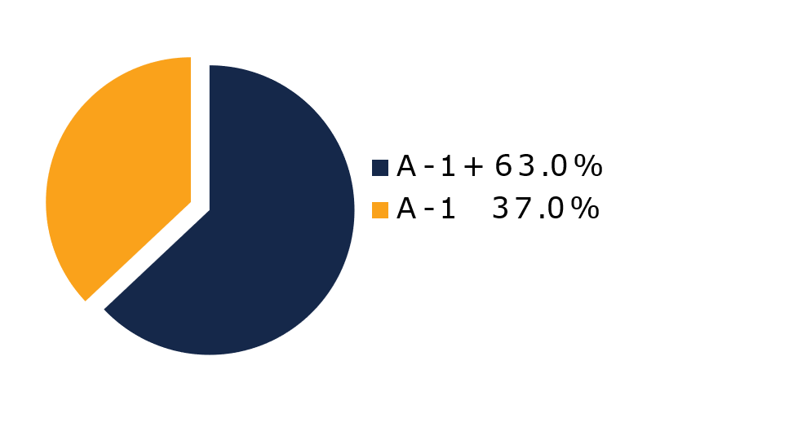
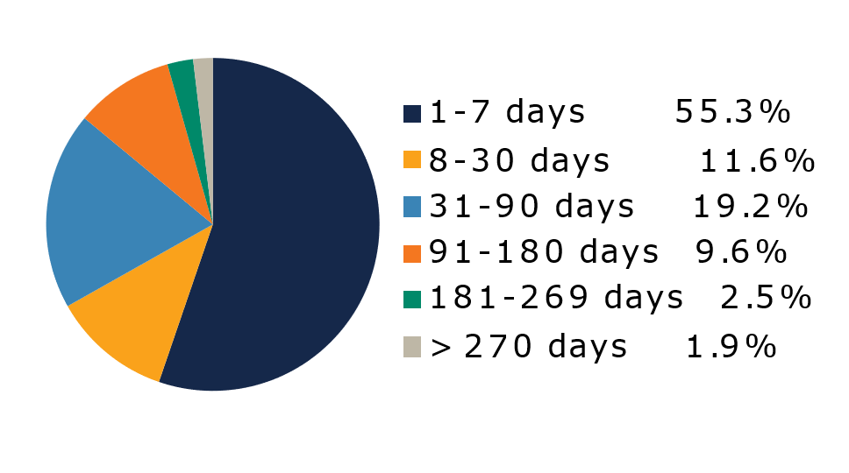
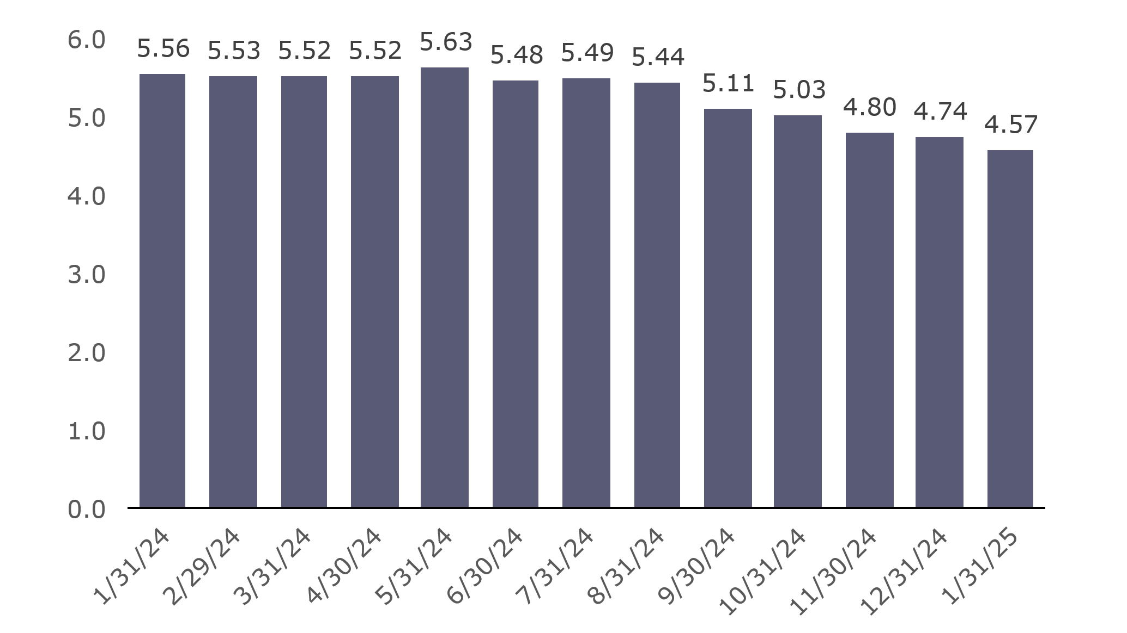
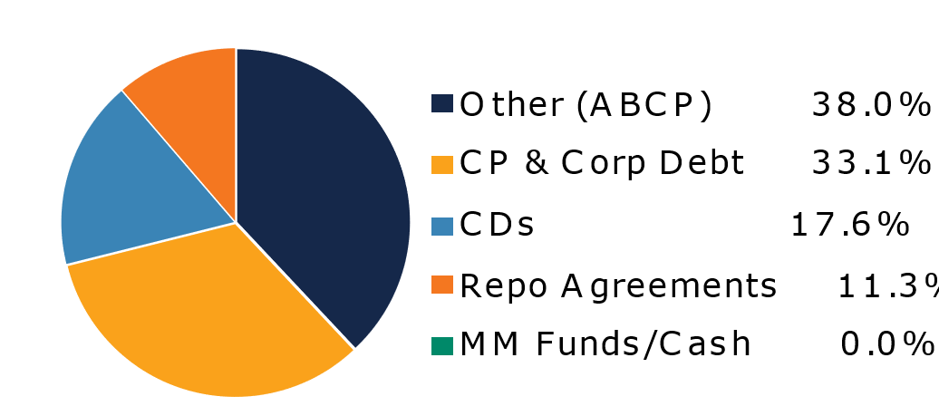
West Virginia Money Market Pool
Portfolio Overview as of 01/31/2025
Pool Assets
$9.2 billion
The West Virginia Money Market Pool is a money market portfolio created to invest the majority of the state and local government operating funds. The objective of the portfolio is to maintain sufficient liquidity to meet the needs of the participants while striving to earn a return above inflation. The risk factor is low and managed through numerous maturity restrictions, diversification, guidelines, and credit limits.
Pool Features and Benefits:
Professional management is provided by the West Virginia Board of Treasury investments’ staff and professional investment advisors (Federated Hermes and UBS Global Asset Management). Rated AAAm by Standard & Poor’s. Seeks to maintain a net asset value (NAV) of $1 per share. Investment yields are competitive with other money market accounts. Easy access is provided through the State Treasurer’s Office online system. Account can be opened for as little as $100 with no limit on the number of transactions. Contributions and withdrawals are allowed daily. Income is distributed on a daily basis.
7-Day Simple Money Market Yield (%)
To learn how to make the West Virginia Money Market Pool work for your cash investing needs call: 304-340-1564 or visit: wvbti.org
Portfolio holdings and composition are shown as of the date indicated. Since market conditions fluctuate suddenly and frequently, the portfolio holdings may change and this list is not indicative of future portfolio composition. These portfolio holdings are not intended to be and do not constitute recommendations that others buy, sell, or hold any of the securities listed. An investment in the Pool is not insured or guaranteed by any government or government agency. Although the manager of the Pool seeks to preserve principal, it is possible to lose money by depositing money in the Pool. A AAAm rating by Standard & Poor’s is obtained after S&P evaluates a number of factors, including credit quality, market price exposure and management. Ratings are subject to change and do not remove market risk.
Credit Quality Composition (%)
Maturity Schedule (%)
Portfolio Composition (%)
Weighted Average Maturity
39 Days
Top Holdings (%)

Slide 2
Board of Treasury Investments | Fact Sheet
Commentary
Don’t be distracted by the Fed drama
We want inflation to fall while the economy and labor market remain strong. Everyone deserves this, and it’s the reason the Federal Reserve decided last week to pause its rate-cutting cycle, leaving the fed funds target range at 4.25-4.50%. But investors in liquidity products have benefited from the elevated interest rates and should continue to if the pace of easing slows. The yields of most securities that funds and other vehicles hold are based on the market, rather than administered, meaning they tend to track the Fed moves. There’s no better way to see this than looking at the recent asset flows into industry liquidity products since the Fed’s December rate cut and year-end 2024. Offshore/European money funds are experiencing the same growth, hitting a record high of $1.463 trillion recently, according to Crane Data, despite the European Central Bank and the Bank of England cutting rates.
But holding rates steady is not the only way the Fed can help cash investors. Its Reverse Repo Facility (RRP) offers an overnight rate for securities set at or above the lower bound of the target range. It allows money market funds managers (not every liquidity product qualifies) to borrow from the Fed to ensure they receive adequate compensation for most securities they buy. I bring this up because, after years of setting the RRP level at five basis points above the lower bound, in December, the FOMC set it at that lower band, i.e., at 4.25% rather than 4.30%. We have anticipated that move for some time, and the result followed our expectation, as the front end of the Treasury and prime yield curves adjusted down in an orderly fashion. The good news is that market participant usage of the RRP has dropped significantly and marketplace rates have been generally higher. It is also due to good old supply and demand. At present, the marketplace has enough of the former that sellers must offer higher rates. But supply is going to dwindle if the federal government doesn’t raise the country’s debt limit, pushing rates down. Get it together, Congress.
In his press conference following the Federal Reserve policy meeting last week, Chair Jerome Powell tried to appear nonchalant about President Trump’s recent remark that he would “demand” rate cuts. But it sure seemed Powell was boiling on the inside. He curtly told reporters he would not discuss Trump’s comments in response to the very first question he fielded and was brusque when asked again. When reporters broadened the issue by asking how the Fed is preparing for potential tariffs, he tellingly responded by saying it’s not the Fed’s job to “criticize” administration policy. But when he made the point again, he added “or to praise.” That didn’t placate Trump, who lashed out at the decision to keep rates steady in a social post. It’s going to be fun watching this clash of the titans over the remainder of Powell’s term. Powell might have a mediator in Scott Bessent, the hedge fund manager whom the Senate confirmed as the new secretary of the Treasury. He has stated that Powell will serve out his term and that the Fed should be independent.

